Slide 1
Gender Differences in Self-Defensive Gun Use
A Descriptive Visual Analysis of 1992-2014 Crime Reports from the National Crime Victimization Survey
Erik S. Jorgenson

Slide 2
Agenda
Defensive Gun Use, Firearm Ownership, and Injury in the U.S.
Defining Parallel Coordinate Plots (PCPs)
PCPs for Categorical Data
Visualizing Defensive Gun Users: 1992-2014 Self-Reports
Implications for Future Research
Questions

Slide 3
“It’s better to have a gun, and not need it …
… than to need a gun, and not have it.”

Slide 4
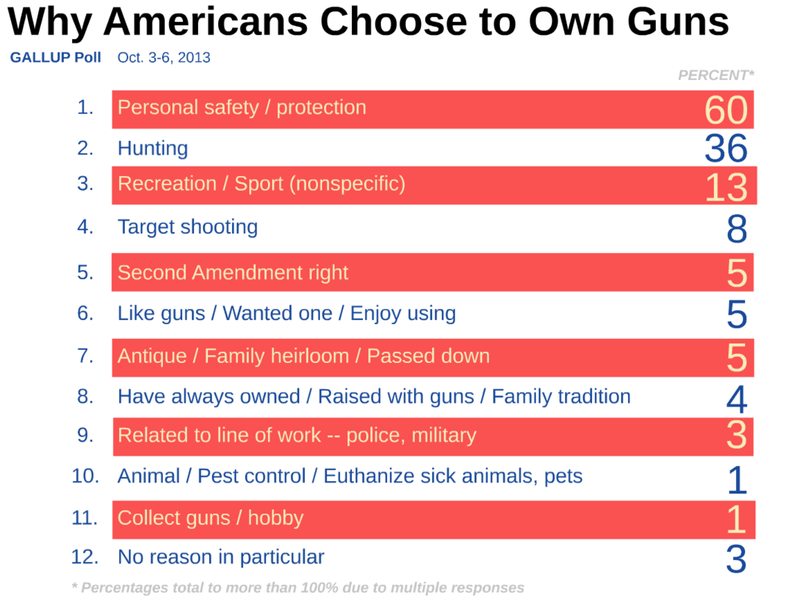

Slide 5
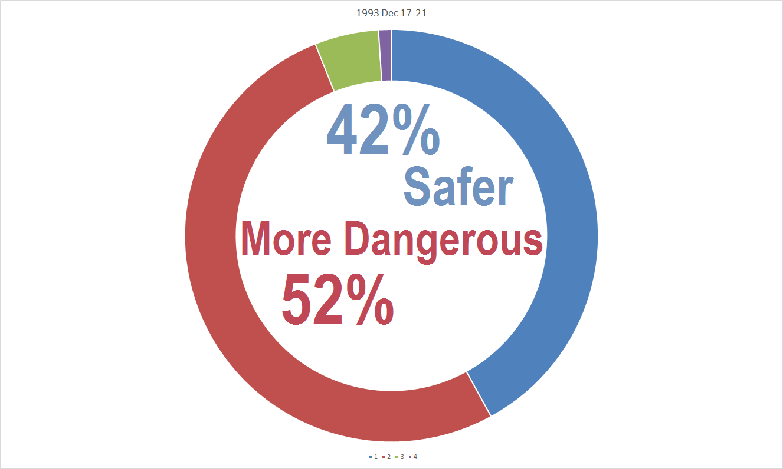
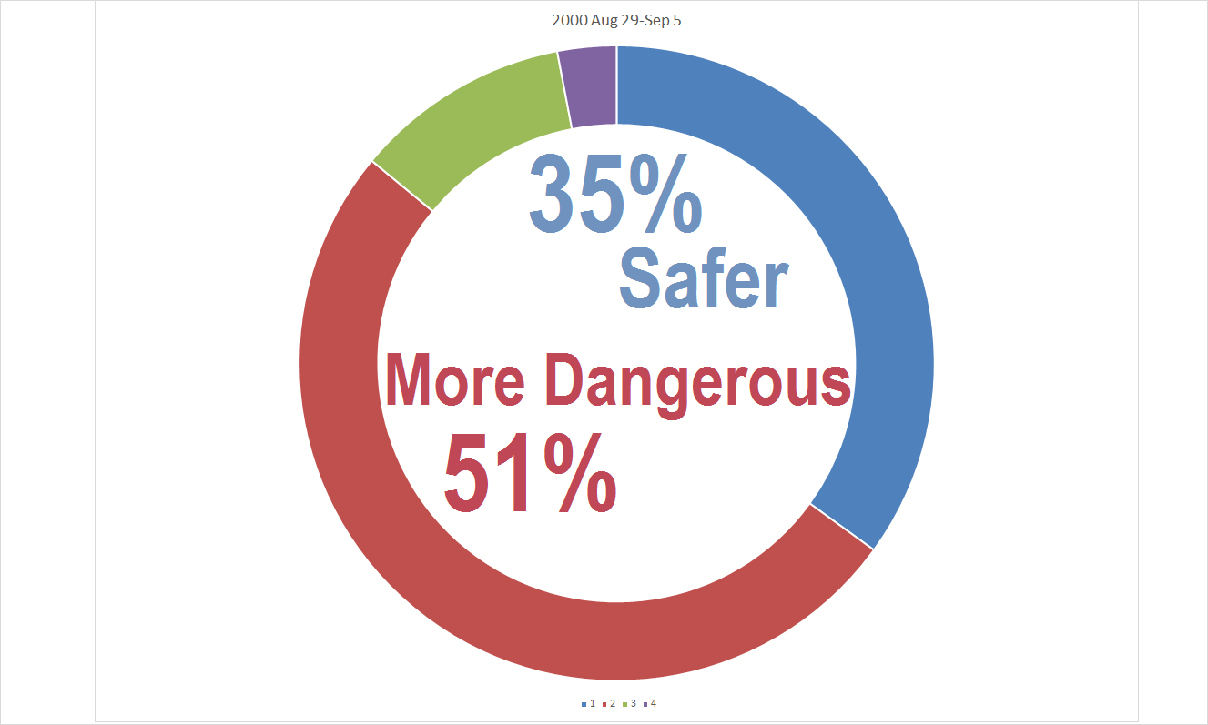
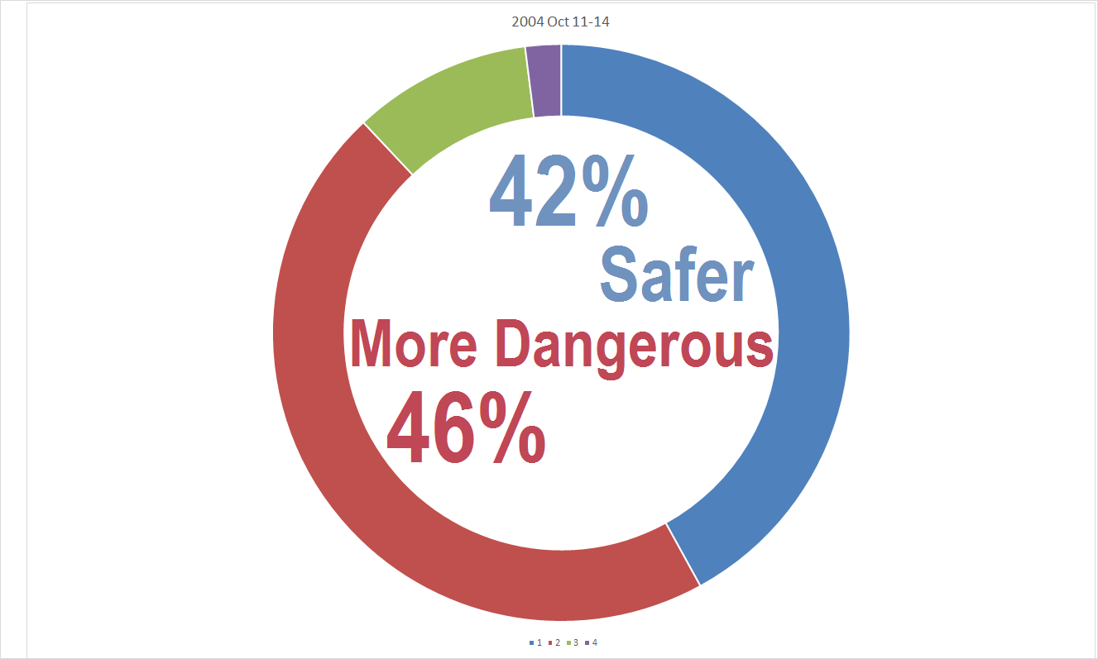
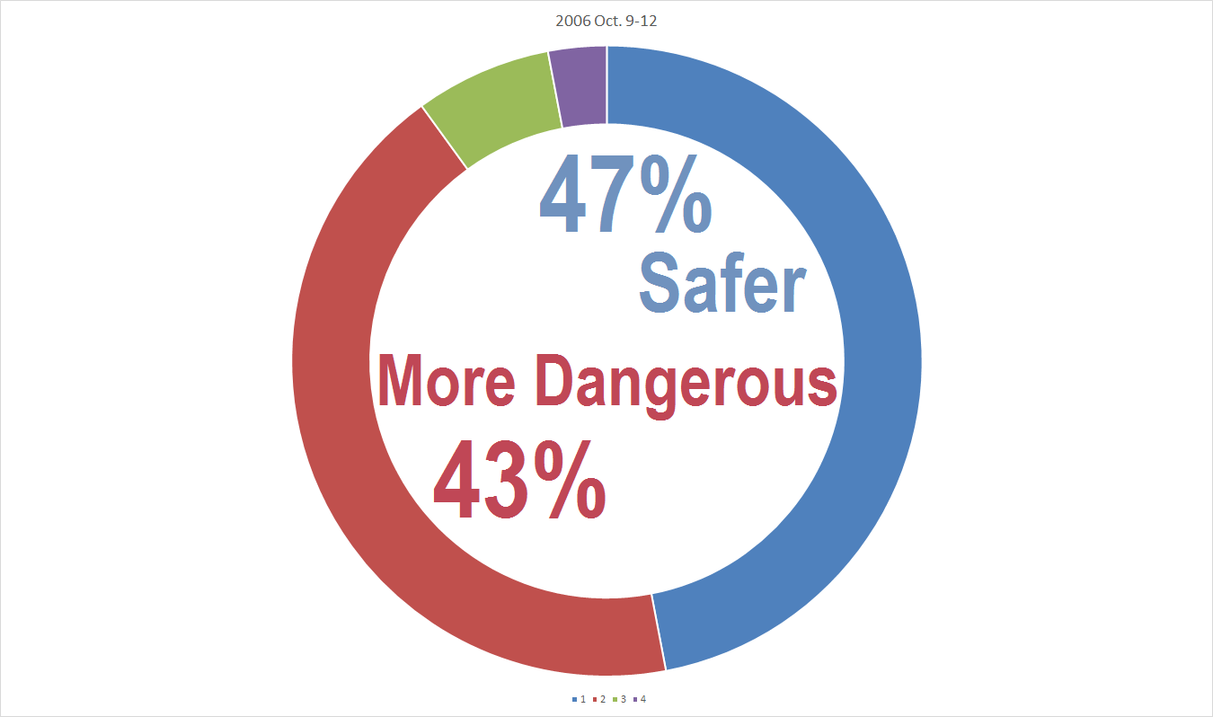
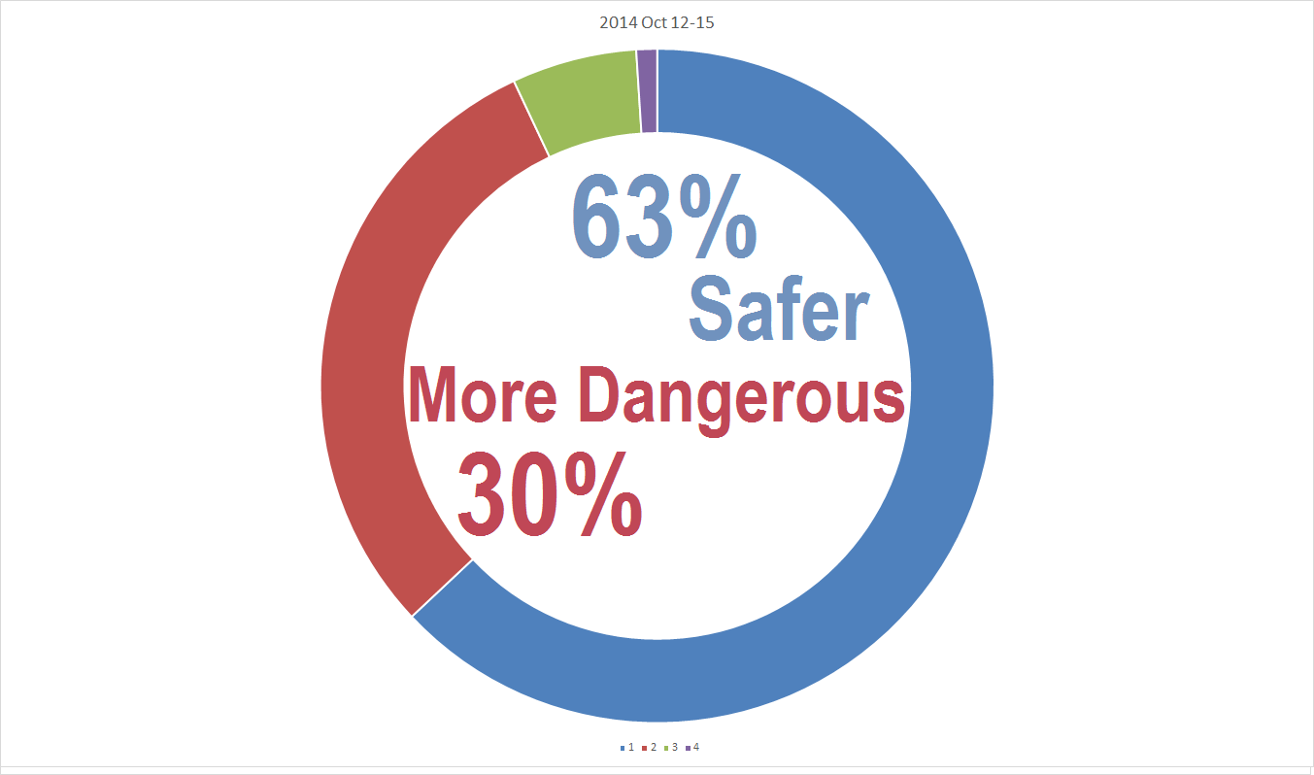
“Having a gun in the house makes it a safer place to be because you can protect yourself from violent intruders …
… having a gun in the house
makes it a more dangerous place to be
because you can increase the risk from gun accidents and domestic violence?”
OR
1993
2000
2004
2006
2014

Slide 6
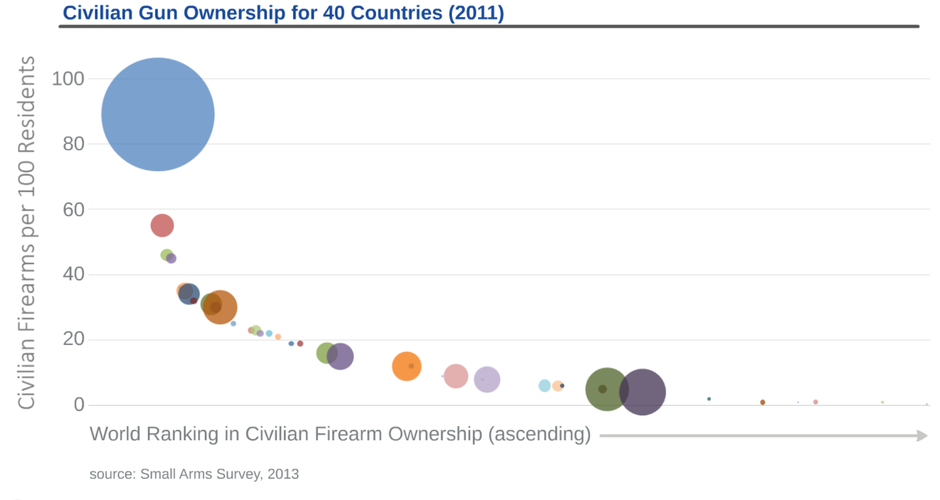
United States of America
World Rank: 1
Firearms per 100 Residents: 89
Civilian Firearms: 270 million
England & Wales
World Rank: 88
Firearms per 100 Residents: 6
Civilian Firearms: 3.4 million
Switzerland
World Rank: 3
Firearms per 100 Residents: 46
Civilian Firearms: 3.4 million
China
World Rank: 102
Firearms per 100 Residents: 5
Civilian Firearms: 40 million

Slide 7
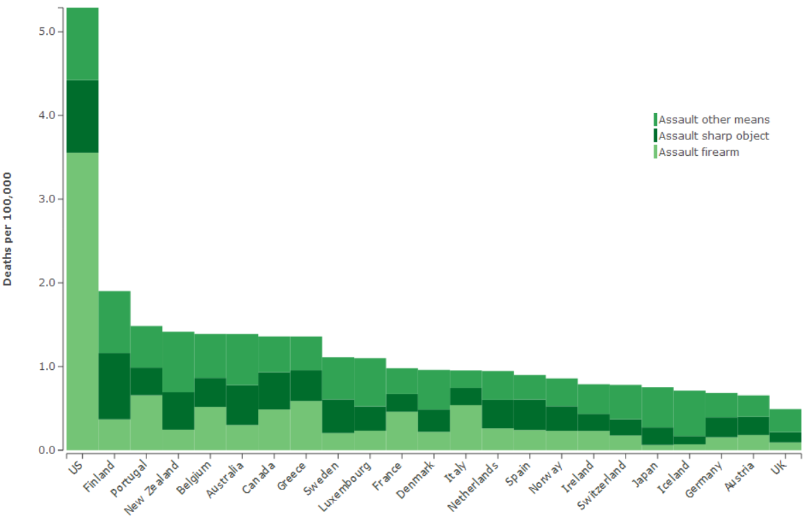
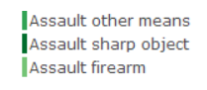
Homicide rates in the U.S. and Peer Countries by Weapon Type: 2013
source: Global Burden of Disease Study, Institute for Health Metrics and Evaluation

Slide 8
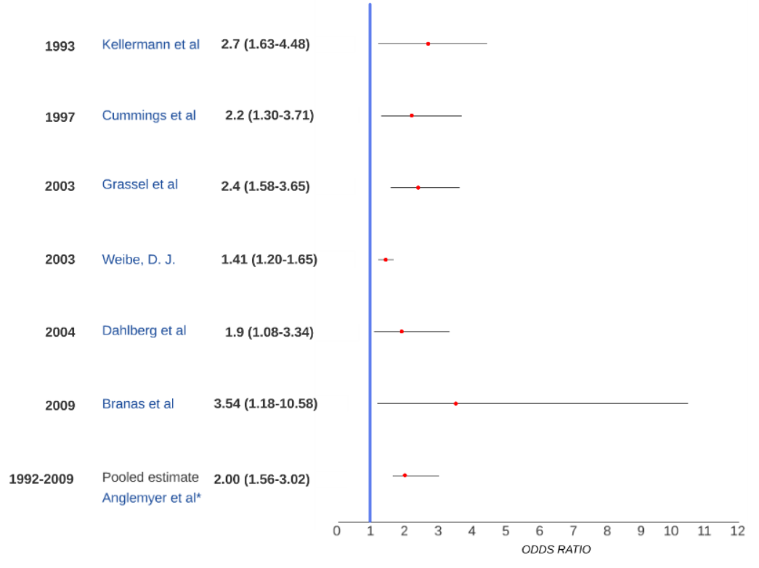
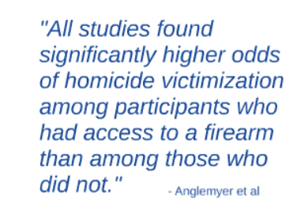
Access to Firearms and Risk of Homicide
Year
Study
Odds Ratio

Slide 9
PCPs: the basics
Visualization strategy for multivariate data
Data is repeatedly plotted on parallel axes
Corresponding points are connected with poly-lines
Each poly-line represents a single row (observation) in the database

Slide 10
Descriptive Visual Analysis
Purpose
Data
To explore and describe visual patterns in contextual, behavioral and outcome measures for self-defensive gun use (SDGU) incidents according to victim gender
522 self-defensive SDGU incidents collected by the NCVS between 1992 - 2014
Subgroup analysis: 168 SDGU incidents with complete injury data
Method
Iterative parallel coordinate visualization of SDGU incident cases organized by victim gender.

Slide 11
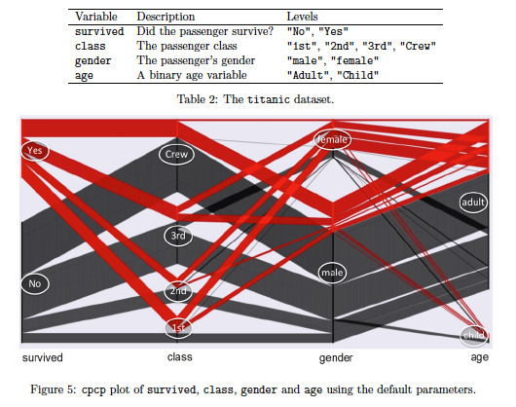
Parallel Coordinates of Categorical Data
Powerful tool for visualizing a high number of variables in one display without dropping information on the raw data values (i.e. aggregate frequency counts)
Within each variable, each category is assigned a sequence of equidistant points with one point for each case and a range proportional to each category’s relative frequency
Dataset is recursively sorted starting with the last variable (ending with the first) which leads to a display which shows a hierarchical splitting structure from left to right

Slide 12
Advantages
Aid in pattern-finding: some high-dimensional relationships transform into easily seen 2-D patterns
Compact: many variables can be shown simultaneously
Limitations
Ordering: selecting axes alignment is a subjective process
Software: very few publicly-available programs/packages that convert databases into parallel coordinates plots (in particular, for categorical data)
Original concept does not allow for categorical variables

Slide 13
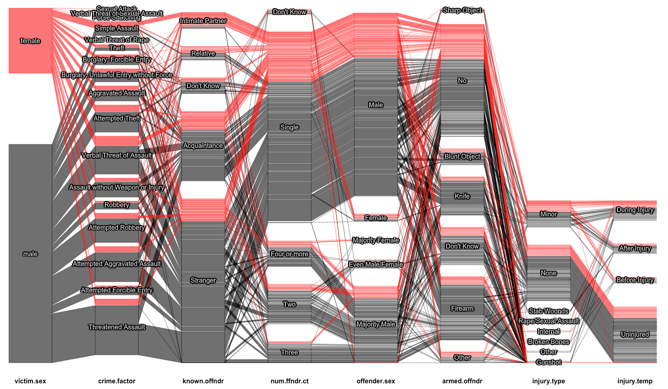
Figure 1: All NCVS DGU Cases from 1992-2014 in which the respondent indicated that they saw the offender (N = 522)
Gender Type of Crime Offender Type # Offenders Off. Gender Armed Off. Injury Type DGU Injury Temp.

Slide 14
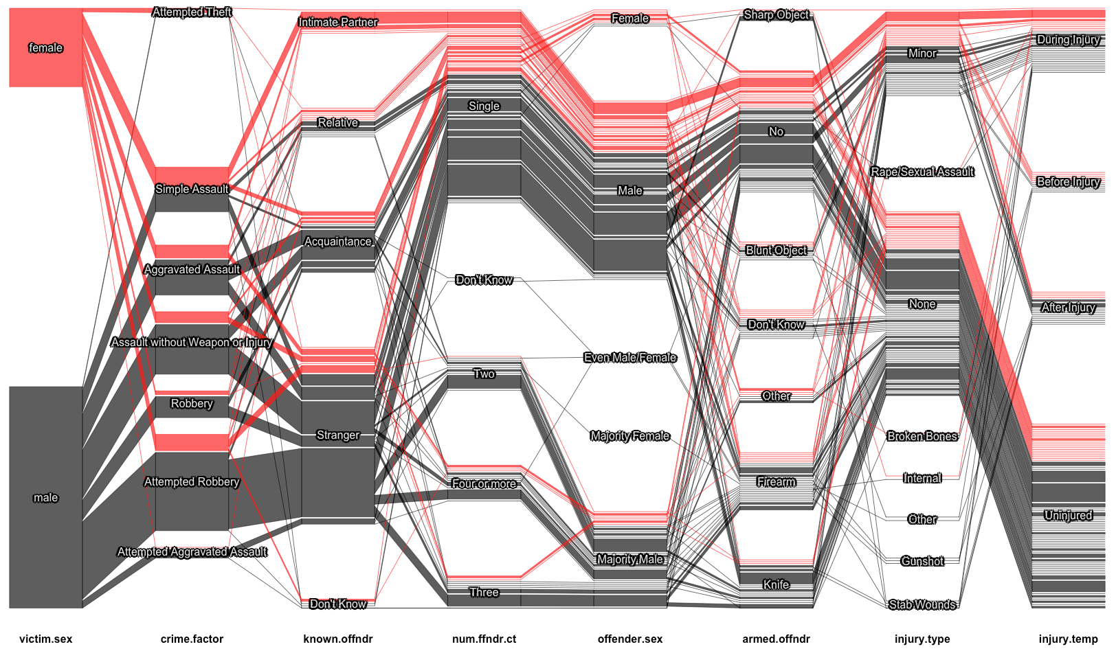
Figure 2: DGU cases with complete data on the injury and temporality variables (n = 168)
Gender Type of Crime Offender Type # Offenders Off. Gender Armed Off. Injury Type DGU Injury Temp.
Notes:
What can we learn about helpfulness of DGU?

Slide 15
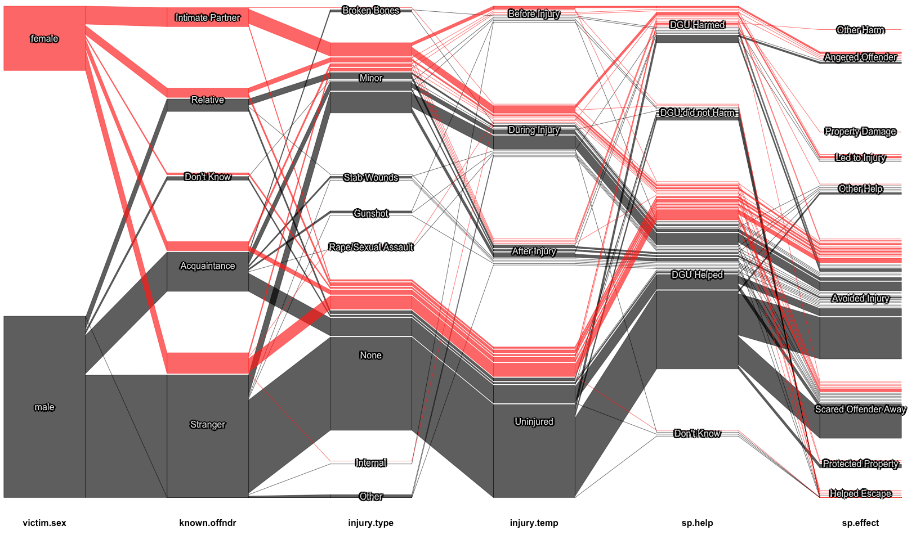
Figure 3: Examining the Effectiveness of DGU by Helpfulness, Harmfulness and Mechanism (n = 168)
Gender Offender Type Injury Type DGU Injury Temp. DGU Effect DGU Effect Mechanism

Slide 16
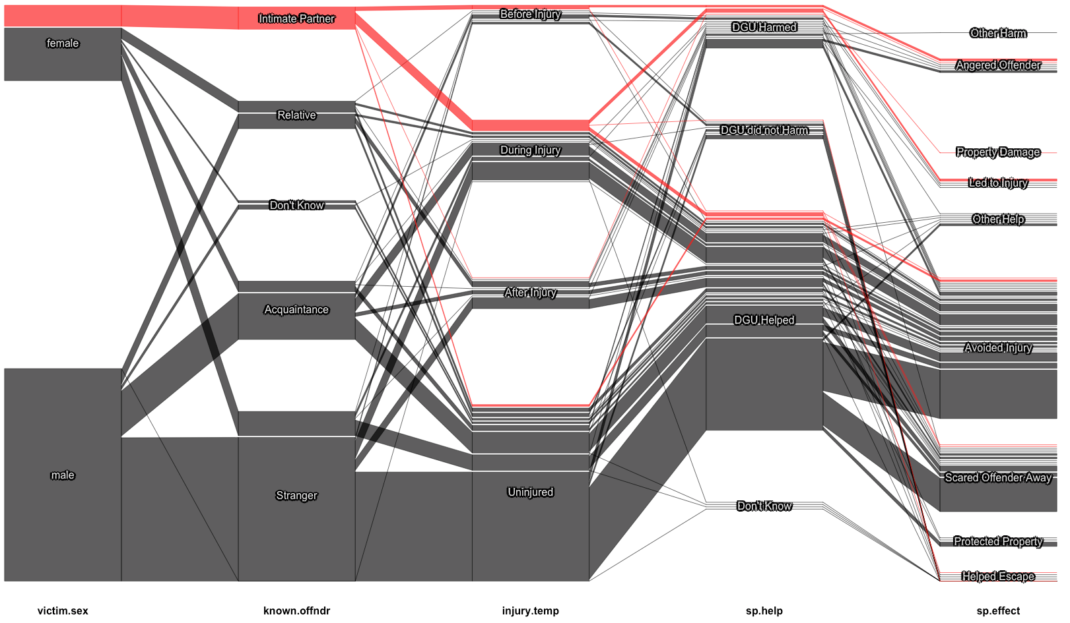
Figure 4: Examining the Effectiveness of DGU by Helpfulness, Harmfulness and Mechanism According to Offender Type: Intimate Partner (n = 168)
Gender Offender Type DGU Injury Temp. DGU Effect DGU Effect Mechanism

Slide 17
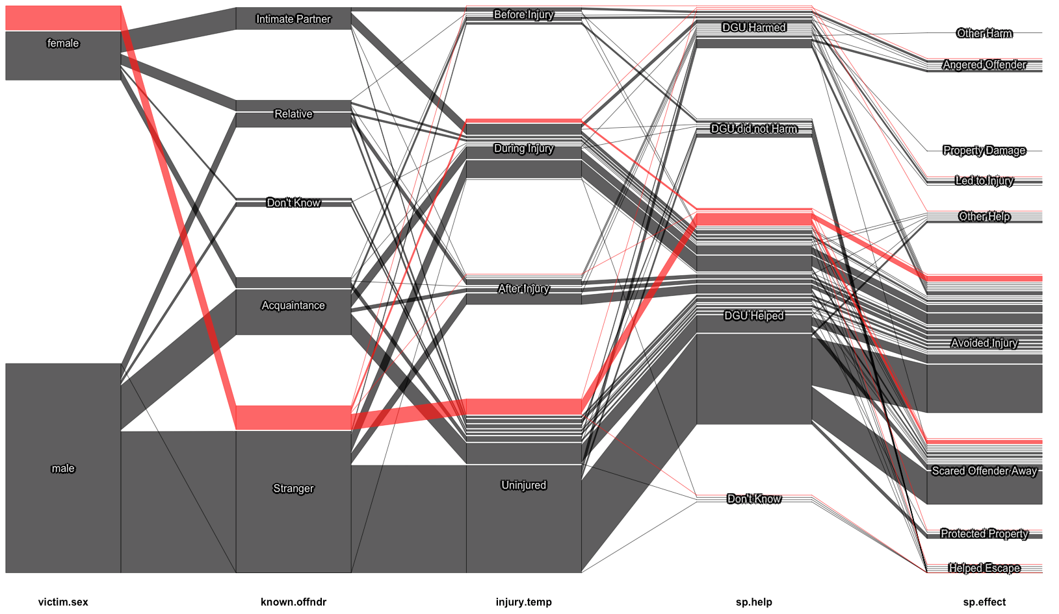
Figure 5: Examining the Effectiveness of DGU by Helpfulness, Harmfulness and Mechanism According to Offender Type: Stranger (n = 168)
Gender Offender Type DGU Injury Temp. DGU Effect DGU Effect Mechanism

Slide 18
Conclusions
Readily observable differences exist between male and female sdgus
Female SDGUs more often encountered known offenders (relatives and intimate partners) than male SDGUs
Female SDGUs more often encountered known offenders than male SDGUs, and injuries resulting from intimate partner violence were infrequently avoided or attenuated by SDGU
SDGU was typically effective in avoiding injury from stranger violence for both male and female SDGUs

Slide 19
Cultural Context

Slide 20

Informing Future Research
Structure more realistic models of complex behaviors
Forecasting
Identify/construct test data to evaluate these models
NIBRS
FBI Supplementary Homicide Reports
Prescriptive Analytics
Suggest decision options
Illustrate the implications of each decision

Slide 21
Questions?
Contact: jerik@mail.med.upenn.edu or e.s.jorgenson@gmail.com

